Slide 1


3905 Century Club Net
by Claus Niesen
April 2nd, 2020
Story County Amateur Radio Club

Slide 2
Presentation Overview
3905 Century Club
Intro
Net Operation
NetLogger Software
Awards
Bureau
Misc.

Slide 3

About Me
Ham since Dec. 2016
Primarily seen on HF (SSB & Digi)
Interest in experimenting and building
Antennas, balun & chokes
Electronics
Software
Motto: I’m the amateur in amateur radio!
Web: cqqrz.github.io Twitter: @cqqrz

Slide 4
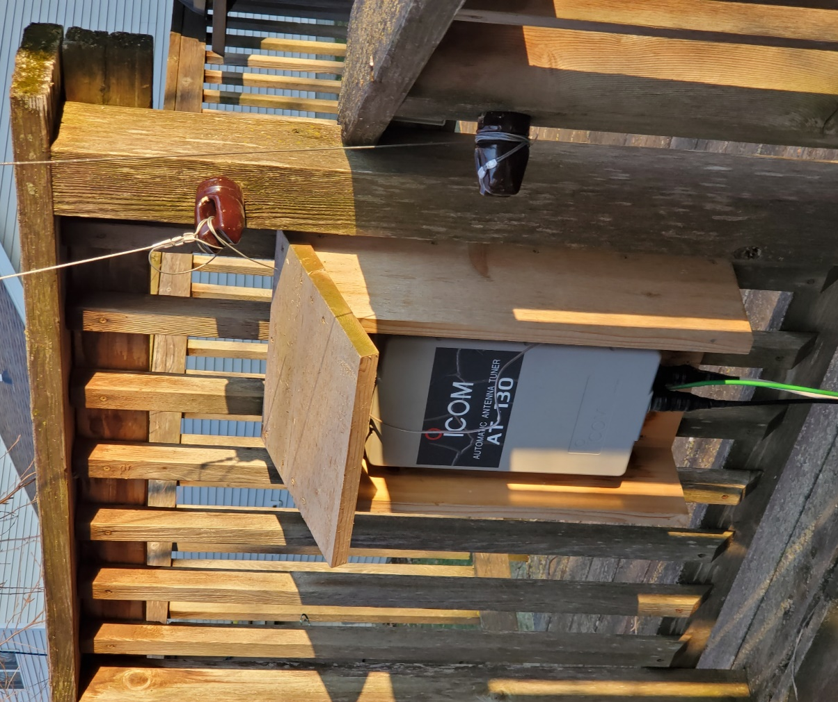
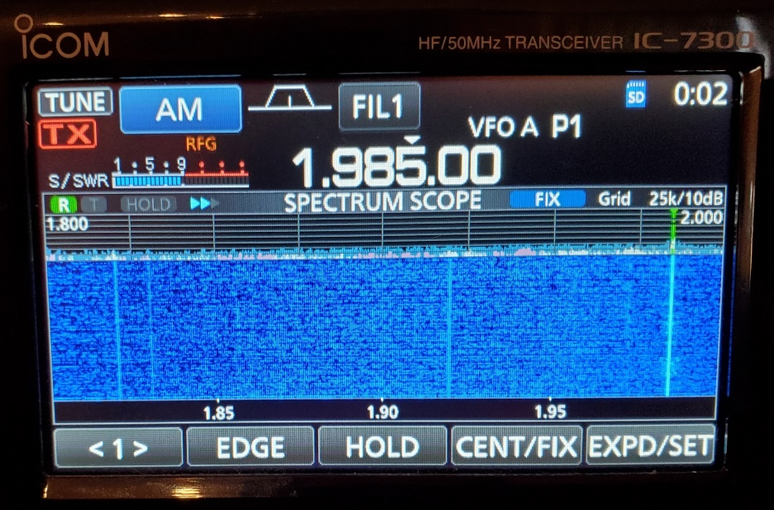
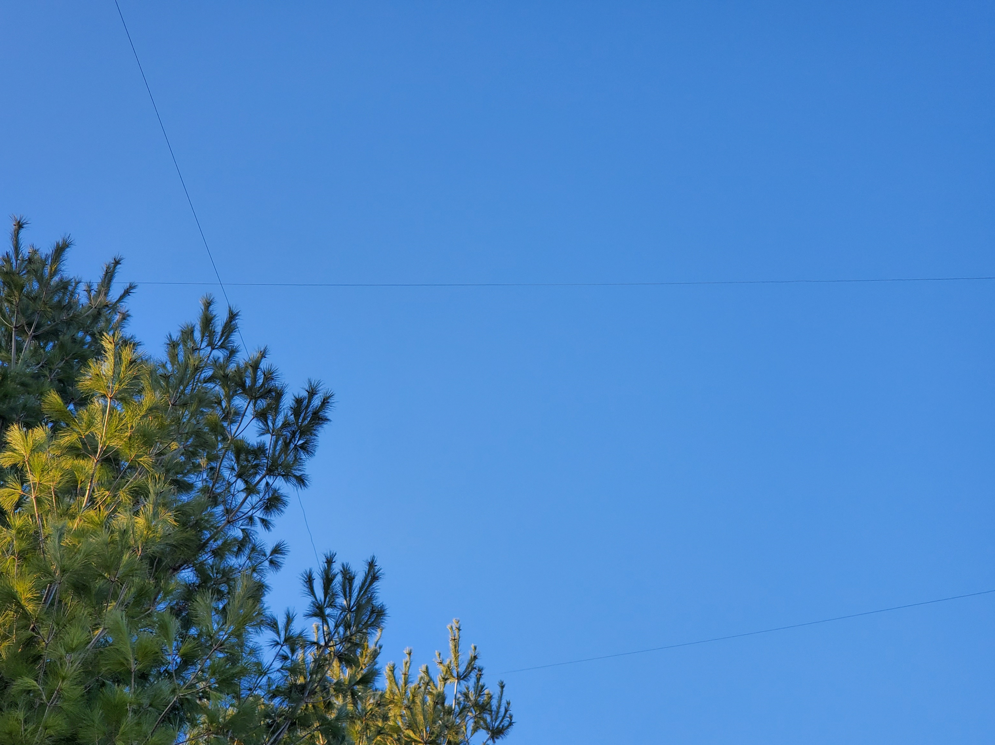
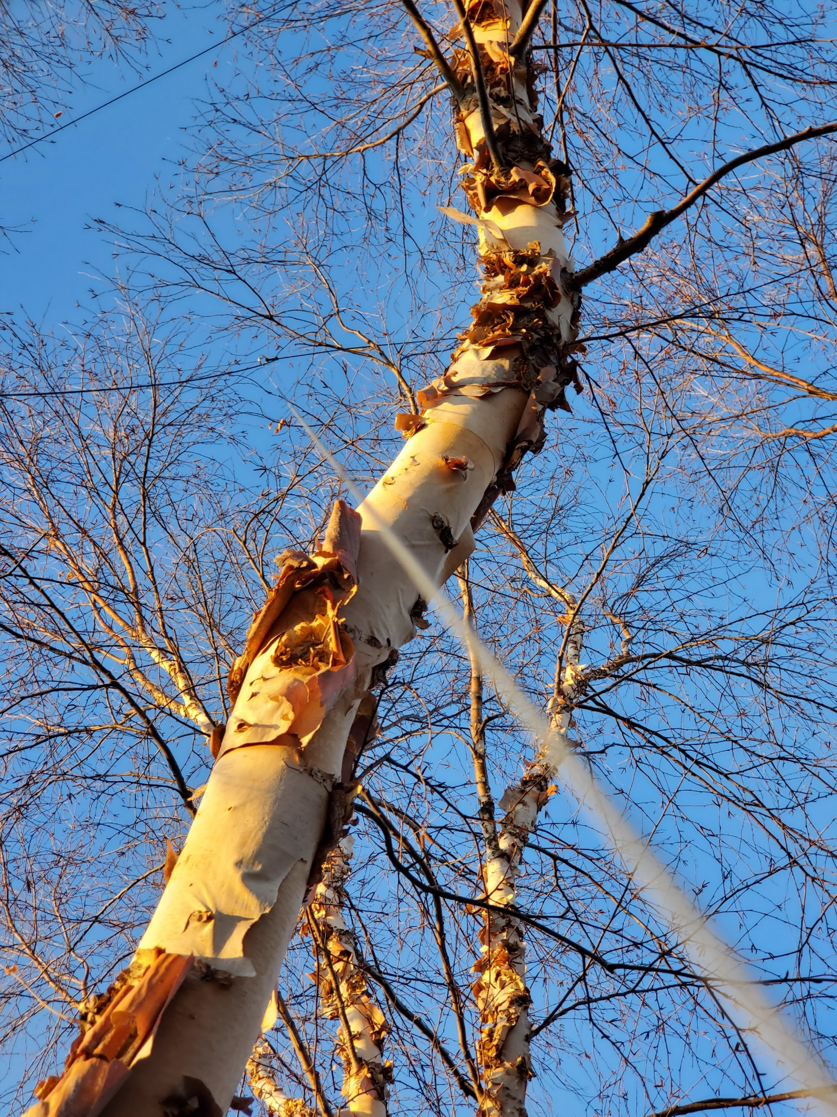
160m
desire

Slide 5
3905 Century Club
Founded February 7, 1977
Primary Purpose: Make contacts and exchange QSL cards
Nets on 20, 40, 80 and 160m bands
Modes: SSB, CW, RTTY and PSK31
Schedule:
http://www.3905ccn.com/netsched.htm

Slide 6
3905 Century Club Net
Pre check-ins (before net start time)
Announcements
Check-ins by call area (DX, 1, 2, …, 9, 0)
Each station is assigned a line number on the list
Run through the list – each station can:
Make a call to another station
“up for grasps”, invitation for other station to call you
“take a pass”, skip your turn
Closing announcements

Slide 7
QSO
Calling line # 14 KI0A from AE0S, do you copy?
AE0S, you are 33
Thanks for the 33, you are 21, copy?
Got your 21, KI0A
KI0A this is AE0S, last heard you were 45.
AE0S, thanks for the 45, you are also 45. KI0A
QSL the 45, thanks for the contact.
(NC) That’s a good call. #16 W0YR, Paul your call.

Slide 8
Sending Numbers
22, 2x2 (two-by-two)
Alternates:
21 – minimum
22 – rifle shot
33 – triple triple
59 – maximum

Slide 9
The manly List
Paper list:
# | Call | State | Sent | Received
1 | K7TOP | OK | 0
2 me | AE0S |  | - | -
..
14 | W0YL | IA | 45 | 45
15 checked out
16 | AC2MT | NY | 47

Slide 10
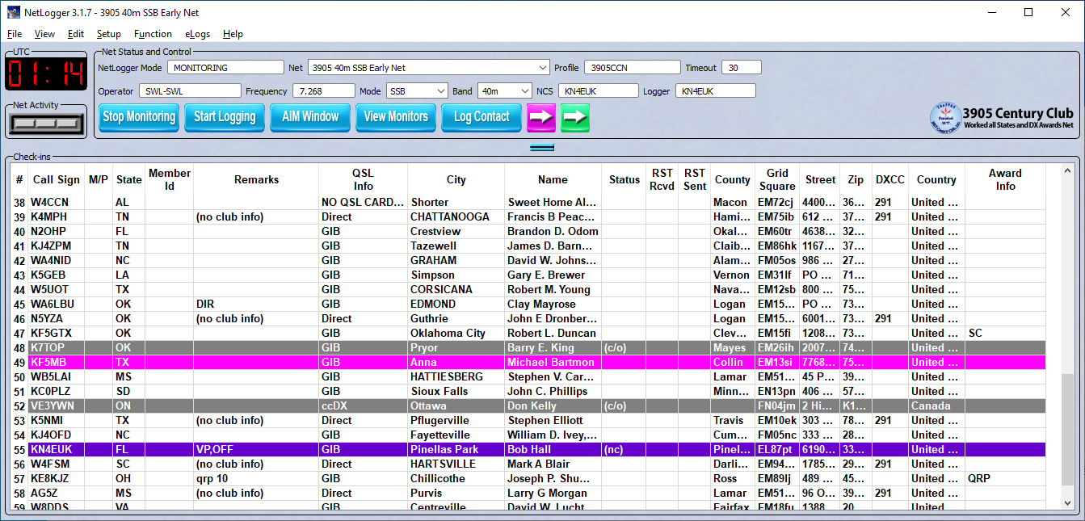
NetLogger
Windows, Mac, and Linux https://www.netlogger.org/

Slide 11
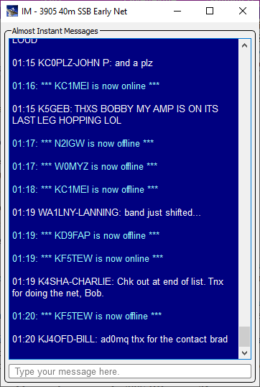
NetLogger – Almost Instant Messages (AIM)
Can’t assist with QSOs
For side chats
Checkouts if it’s not your turn or calls for check-ins
Optional

Slide 12
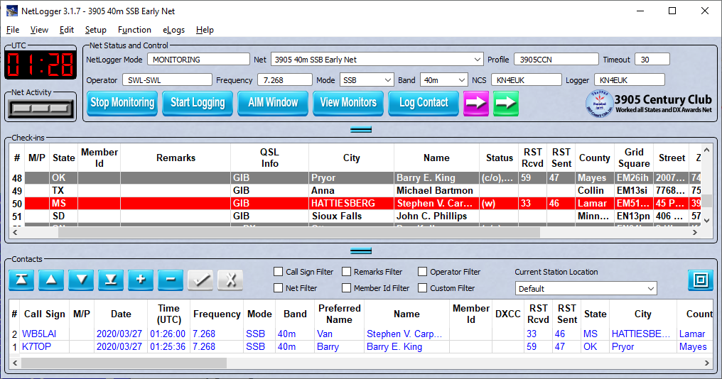
NetLogger - Contacts
Exports: ADIF, CSV

Slide 13
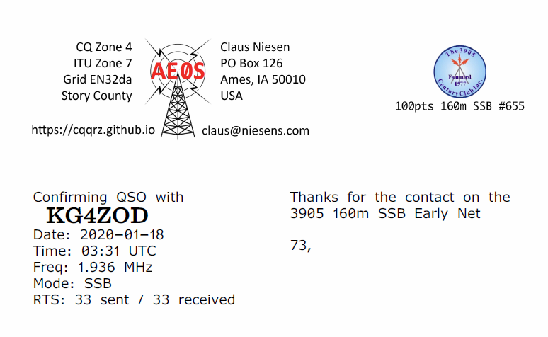
NetLoggerElf (extreme alpha software)
Java command line app
Reads LetLogger CSV
Prints QSL cards to PDF
Inserts QSOs into Log4OM
https://github.com/cniesen/NetLoggerElf

Slide 14
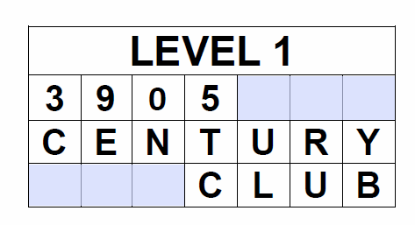
3905 Century Club Awards
Nearly 50 awards
Main award 100, 500, 1000, 2000 points series
eg Crossword Puzzle
eg Baker’s Dozen – contact same mobile/portable in 13 US states
Master award (prestigious)
http://www.3905ccn.com/awards-apps.htm

Slide 15
3905 Century Club Awards
First award must be a 100 Point Award and is free
Awards are $4/$3 for paper or $2 PDF.
All contacts must be made via the 3905 CC Nets.
Paper QSL and eQSL accepted.

Slide 16
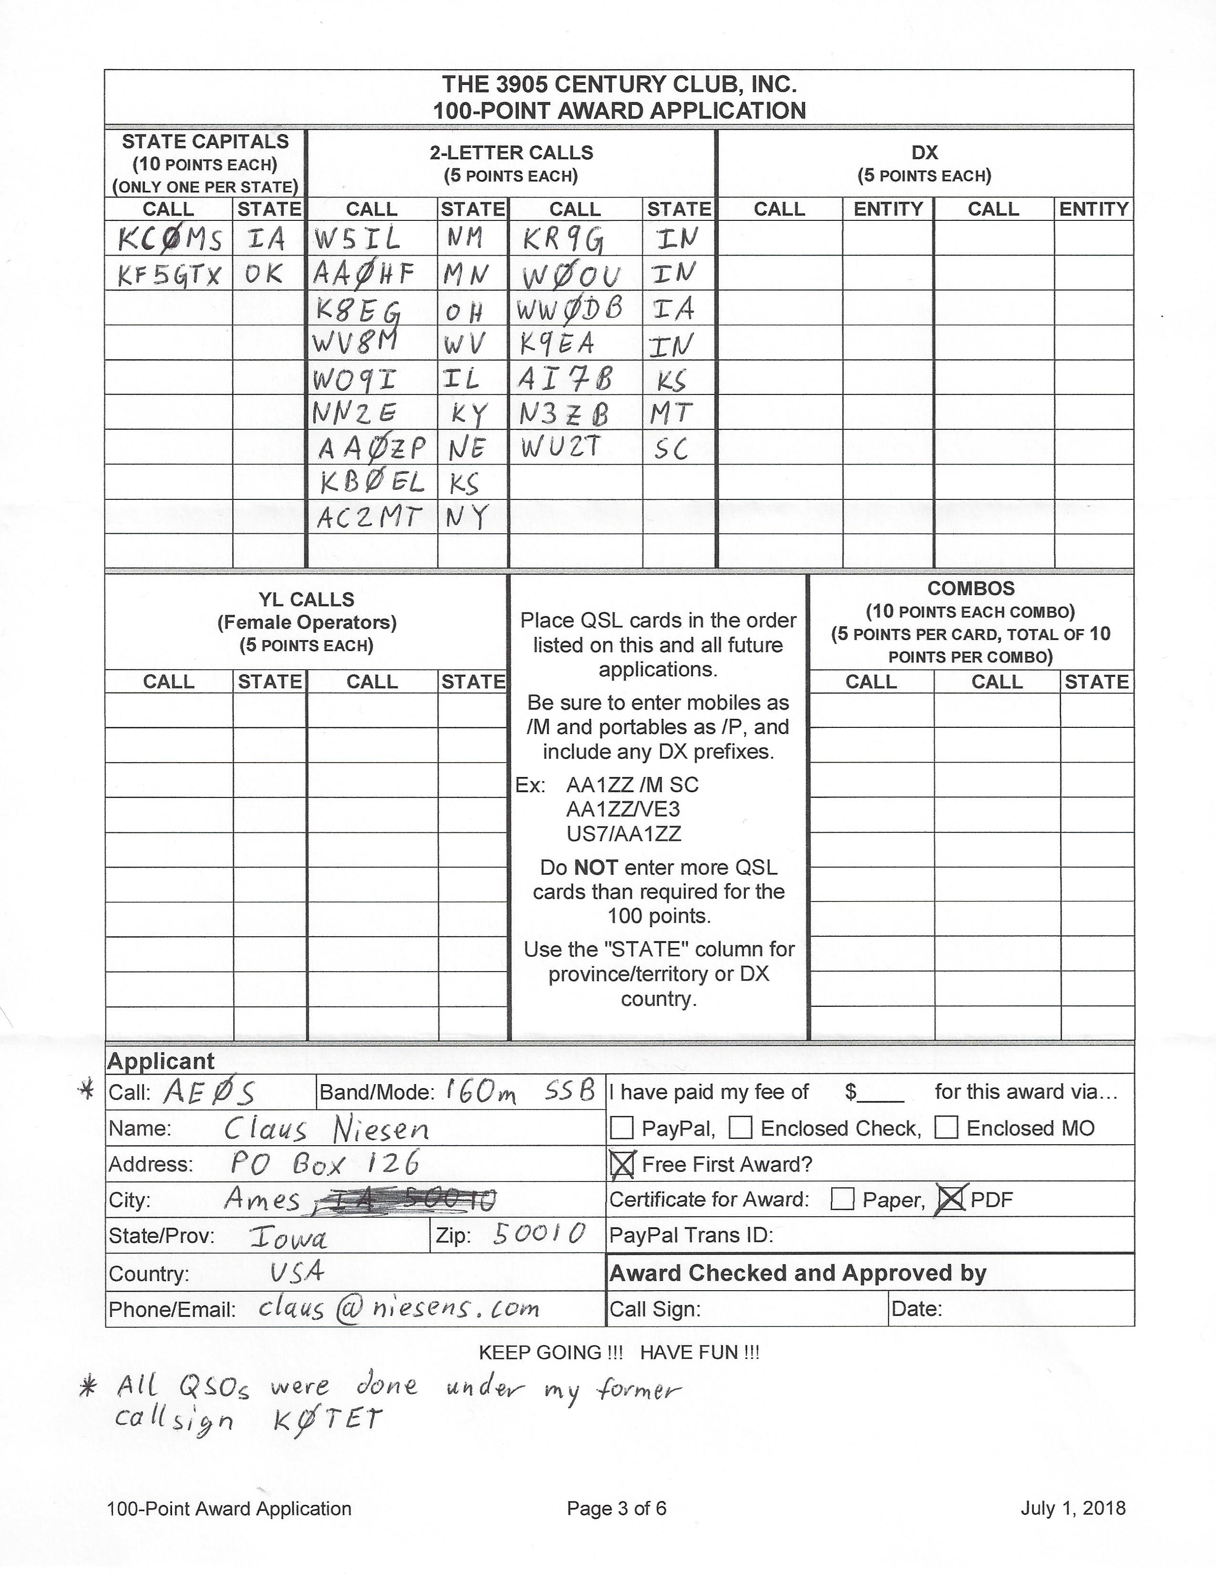
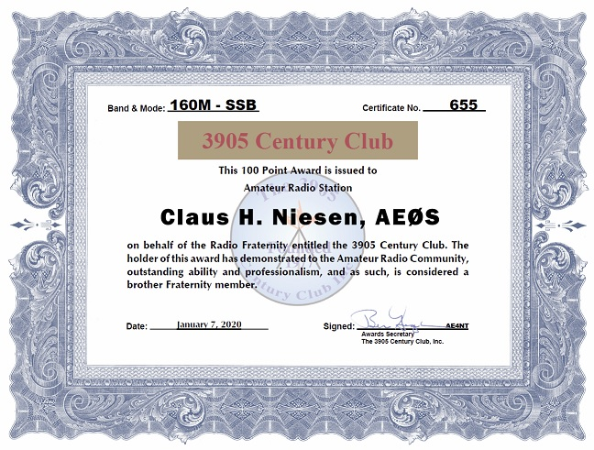
My 1st Award

Slide 17
3905 Century Club Bureau
Very fast, very economical
Totally different than ARRL DX Bureau
Only for 3905 Net contacts
No need to be a member (have 100 Point Certificate)
Just use it!

Slide 18
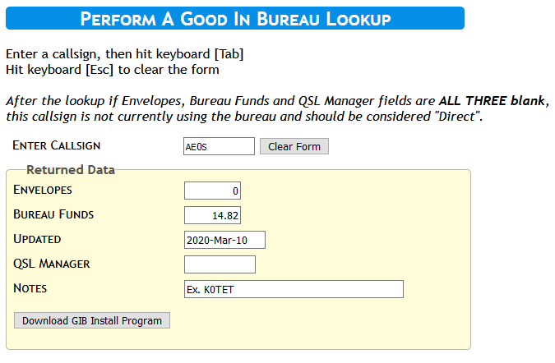
Good In Bureau (GIB)
https://3905ccn.hamshackonline.net/bureau/bureau.php
Enter call
Press tab
Press enter and repeat

Slide 19
3905 QSL Bureaus
All Nets – outbound and inbound QSL
DX QSL Bureau – for outbound cards to non US stations/addresses
Handiham QSL Service – for disabled operators, provides additional services

Slide 20
Bureau Account Options
Envelopes
Why?
Account Balance
Check
PayPal (fees apply)
Cost: postage + $0.19 for envelope

Slide 21
Sending Cards to Bureau
Sort card by call area of recipient’s call sign (1,2, …, 9, 0)
Don’t use photo paper (they stick together)
Keep QSO info on one side (avoids having to flip card when sorting)
Club cards need operator’s callsign

Slide 22
Net Control Operators
Formal training, exam and certificate.
Net Control Station awards
http://www.3905ccn.com/ncsinfo.htm

Slide 23
Club Politics
Officer’s elected for 2 years
Election every year of half the board. Need 100pts Award to vote.
QSOs with officers may be helpful for some awards.
http://www.3905ccn.com/officers.htm

Slide 24
Centurion Newsletter
About quarterly news letter
Color PDF decent size and content
Available online
http://www.3905ccn.com/files/pdf/centurion-current.pdf

Slide 25
Annual Eyeball
5 day meeting in the summer
Presentations
Socializing
Mobile Shootout
About 50 attendees
July 15-19, 2020 Louisville MS
https://eyeball2020.com

Slide 26
Group.io Mailing Lists
General Chat https://groups.io/g/3905Chatgp
Award Discussions https://groups.io/g/3905AwdTalk
Check-in list and real time net related https://groups.io/g/3905Checkins
Net control Stations https://groups.io/g/3905ccnNCS

Slide 27

Time to
ask questions
and
hope for answers

